Slide 1
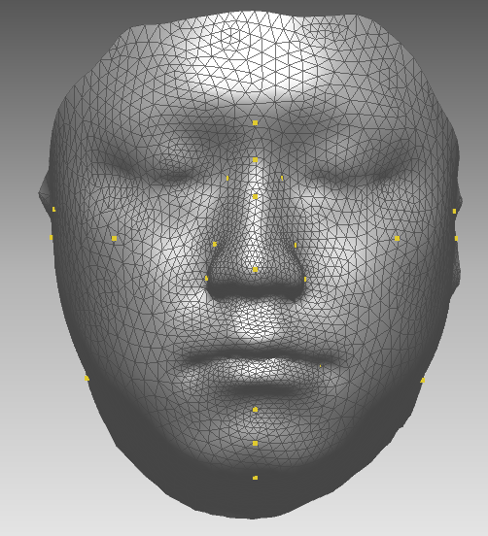
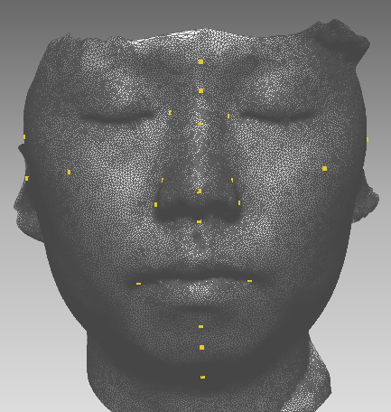
A. Template Registration based on BBW & non-rigid ICP algorithms
This is the template model of Korean pilots having average size.
(# vertex = 922)
This is one of target image among Korean pilots (N = 336).
(# vertex = 37918)
Shape, vertex, mesh, and landmarks of template & target models

Slide 2
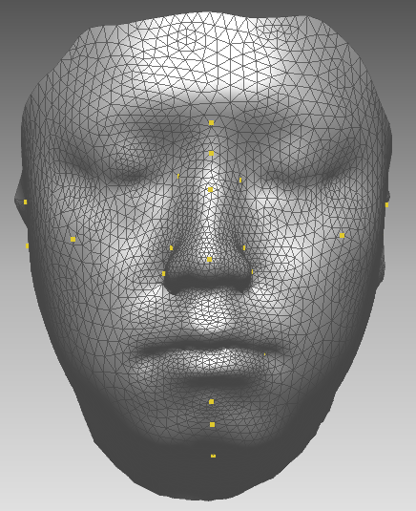
A. Template Registration based on BBW & non-rigid ICP algorithms
Step 1. Relocation of all landmarks of template model (L_{template}; [x, y, z]) to corresponding landmarks of target model (L_{Target}; [x’, y’, z’])
By BBW (bounded biharmonic weights), vertex near each L_{Template} were adjusted proportionally together with L_{Template} when all L_{Template} [x, y, z] move to corresponding L_{Target} [x’, y’, z’].
vertex were proportionally adjusted with L_{Template}
L_{target}
(x’, y’ z’)
LM: same location
Shape: different
L_{template}
(x, y, z)
relocated L_{template}
(x’, y’ z’)
This is the template model.
This is the template model initially morphed based on BBW algorithm.
*BBW algorithm: http://igl.ethz.ch/projects/bbw/

Slide 3
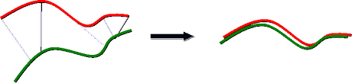
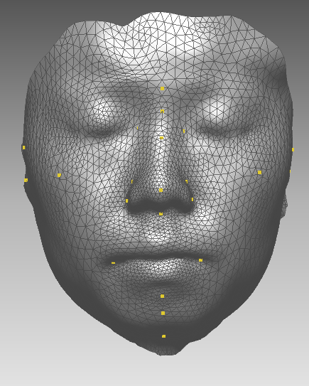
A. Template Registration based on BBW & non-rigid ICP algorithms
Step 2. Registration (or matching or fitting) of the morphed template model to the target image based non-rigid ICP (Iterative Closest Point) algorithm
By the ICP algorithm, each vertex is repositioned on the surface of the target model.
ICP registration
LM: same location
Shape: same
This is the template model initially morphed based on the BBW.
This is the template model registered to the target image based on ICP algorithm.

Slide 4
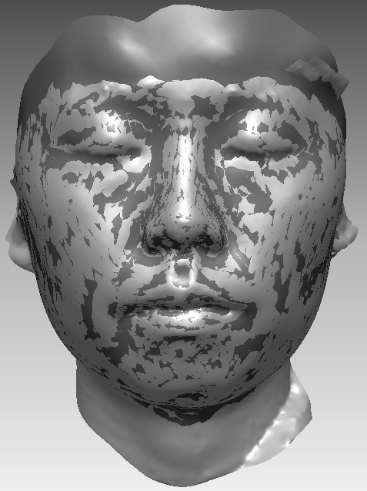
A. Template Registration based on BBW & non-rigid ICP algorithms
Difference between the registered template model (dark gray) and the original target model (light gray).

Slide 5
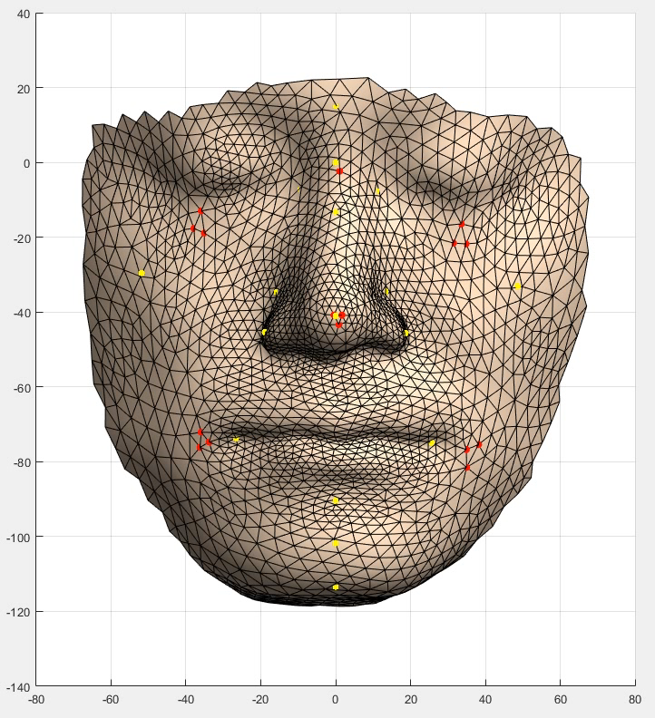
A. Template Registration based on BBW & non-rigid ICP algorithms
Vertex positions are proportionally different between models, but mesh structure is always same (see red dots).
Template model registered to difference faces
red dots: sample points which present at same locations across all registered template faces
yellow dots: landmark of each face

Slide 6
B. Principal component analysis using all vertex
Step 1. elimination of boundary and unnecessary vertex for efficient and accurate analysis
# vertex = 922
# vertex = 691

Slide 7
B. Principal component analysis using all vertex
Step 2. input all 691 vertex in PCA
45.6%
14.7%
6.7%
5.5%
72.5%

Slide 8
B. Principal component analysis using all vertex
Step 2. (cont’d)
PC1
PC2
PC3
PC4
(Red lines present eigenvectors.)

